Slide 1
Application Security Best Practice
Presentation Subtitle Arial Regular 20/24pt

Slide 2
Problem faced in Microservices
Defense in Depth
Authentication and Authorization
OAuth2
JWT Security
Endpoint Protection
CORS

Slide 3
Problem faced in Microservices
A user needs to login to access a resources
The user login details have to be saved in a secure way and user is not asked for verification each and every time he/she tries to access a resources
Client details and permissions need to be verified when a request is sent
For each and every service you have to authenticate and authorize the client
Microservices communicate with each other simultaneously in addition to the 3rd party applications
When a client logs in from 3rd party application, developers have to make sure that client does not get access to the data of microservices in a way that he/she might exploit them

Slide 4
API Centric Security Principle
1. Expose your APIs with fine granular access control built in
Your mobile app designed for users of your public API can support social logins, such as Facebook. A mobile app designed for your employees using a private API may use your corporate directory for authentication and authorization needs. Both products should support OAuth and authorization scope to limit access to different sets of APIs.

Slide 5
API Centric Security Principle
2. Log all API interactions across channels to get an end-to-end view of user, device and app activities
This approach helps provide correlations of user activities across all channels and identify any abnormal behavior that deserves investigation. API analytics can provide insights into traffic spikes from certain devices, apps, IP addresses, or geographies.

Slide 6
API Centric Security Principle
3. Always configure security
Code only when absolutely necessary. Security configuration provides a better experience for developers and helps them adapt security features faster. Threat protection features such as rate limiting and OWASP Top-10 Injection protection act as a defense layer for all channel interactions. But you’ll still need the option to code security for cases where configuration may not be an option. For example, you may need to query your internal SIEM (security information event management) system for malicious sets of IP addresses (black lists) and block the threats across all channels.

Slide 7
API Centric Security Principle
4 . Always layer API security with other controls for a defense-in-depth strategy
Be sure to employ additional access protection between apps and API services. An example: using IP-based whitelisting and two-way SSL/TLS in addition to OAuth-based security.

Slide 8

Defense in Depth
We can apply layers of security technique to protect the sensitive services. Thus, attackers cannot crack the security on a single go and have to go forward to attack all the layers.

Slide 9
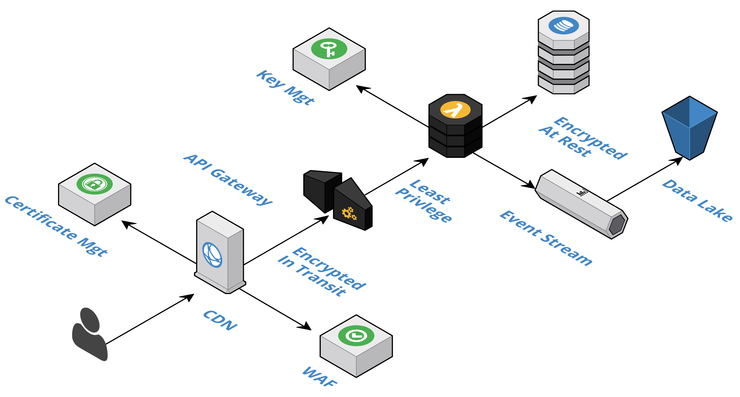
Defense in Depth

Slide 10
Apply Rigorous Authentication and Authorization
Always authenticate and then check authorization for all API callers
Some common authentication techniques are Token Based Authentication (OAuth2) or Basic Authentication over TLS
Use JSON Web Token (JWT) as the security tokens
JWT is a JSON data structure which contains a set of claims that can be used for access control
A cryptographic signature can be used to protect the integrity of the JWT
Do not allow the unsecured JWTs: {"alg":"none"}

Slide 11
JWT Security
JSON Web Token Structure
All Auth0-issued JSON Web Tokens (JWTs) are JSON Web Signatures (JWS), meaning they are signed rather than encrypted. As such, this document describes the JWS structure of a JWT
A well-formed JSON Web Token (JWT) consists of three concatenated Base64url-encoded strings, separated by dots (.)
Header: contains metadata about the type of token and the cryptographic algorithms used to secure its contents.
Payload (set of claims): contains verifiable security statements, such as the identity of the user and the permissions they are allowed.
Signature: used to validate that the token is trustworthy and has not been tampered with. You must verify this signature before storing and using a JWT.
Notes:
In a JWT, a claim appears as a name/value pair where the name is always a string and the value can be any JSON value. Generally, when we talk about a claim in the context of a JWT, we are referring to the name (orkey)
There are two types of JSON Web Token (JWT) claims:
Reserved: Claims defined by the JWT specification to ensure interoperability with third-party, or external, applications. OpenID Connect (OIDC) standard claims are reserved claims.
Custom: Claims that you define yourself. Name these claims carefully, such as through namespacing (which Auth0 requires), to avoid collision with reserved claims or other custom claims. It can be challenging to deal with two claims of the same name that contain differing information.
Reserved claims
The JWT specification defines seven reserved claims that are not required, but are recommended to allow interoperability with third-party applications. These are:
iss (issuer): Issuer of the JWT
sub (subject): Subject of the JWT (the user)
aud (audience): Recipient for which the JWT is intended
exp (expiration time): Time after which the JWT expires
nbf (not before time): Time before which the JWT must not be accepted for processing
iat (issued at time): Time at which the JWT was issued; can be used to determine age of the JWT
jti (JWT ID): Unique identifier; can be used to prevent the JWT from being replayed (allows a token to be used only once)

Slide 12
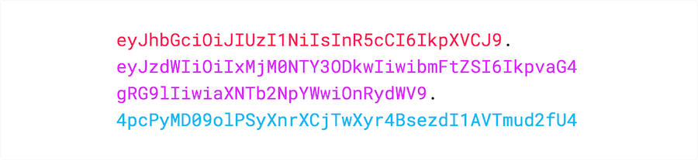
JWT Security
JSON Web Token Structure
A JWT typically looks like this:
Use the JWT.io Debugger. It will allow you to quickly check that a JWT is well formed and manually inspect the values of the various claims.

Slide 13
Turn On SSL Everywhere
Use SSL / TLS to secure the transection for public APIs.
If SSL/TLS is not an option for intranet use services (private APIs), whitelisting the caller IPs/ subnet with existing security infrastructures.

Slide 14
Information Exposure on URLs
Sensitive dada such as passwords, security tokens, and API keys should not appear in URL
For all Post/Put requests, sensitive data should be transferred in request body or request headers
For all Get requests, sensitive data should be transferred in an HTTP Header

Slide 15
Endpoint Protection
Limit requests (Throttling) to avoid DDoS / brute-force attacks.
Check if all the endpoints are protected behind authentication to avoid broken authentication process
Use firewall rules or use of access control lists to restrict access to all endpoints
For security critical APIs, use basic auth with ACL or OAuth2 scoped access token

Slide 16
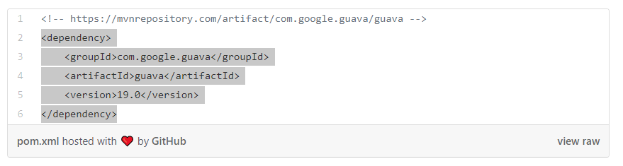
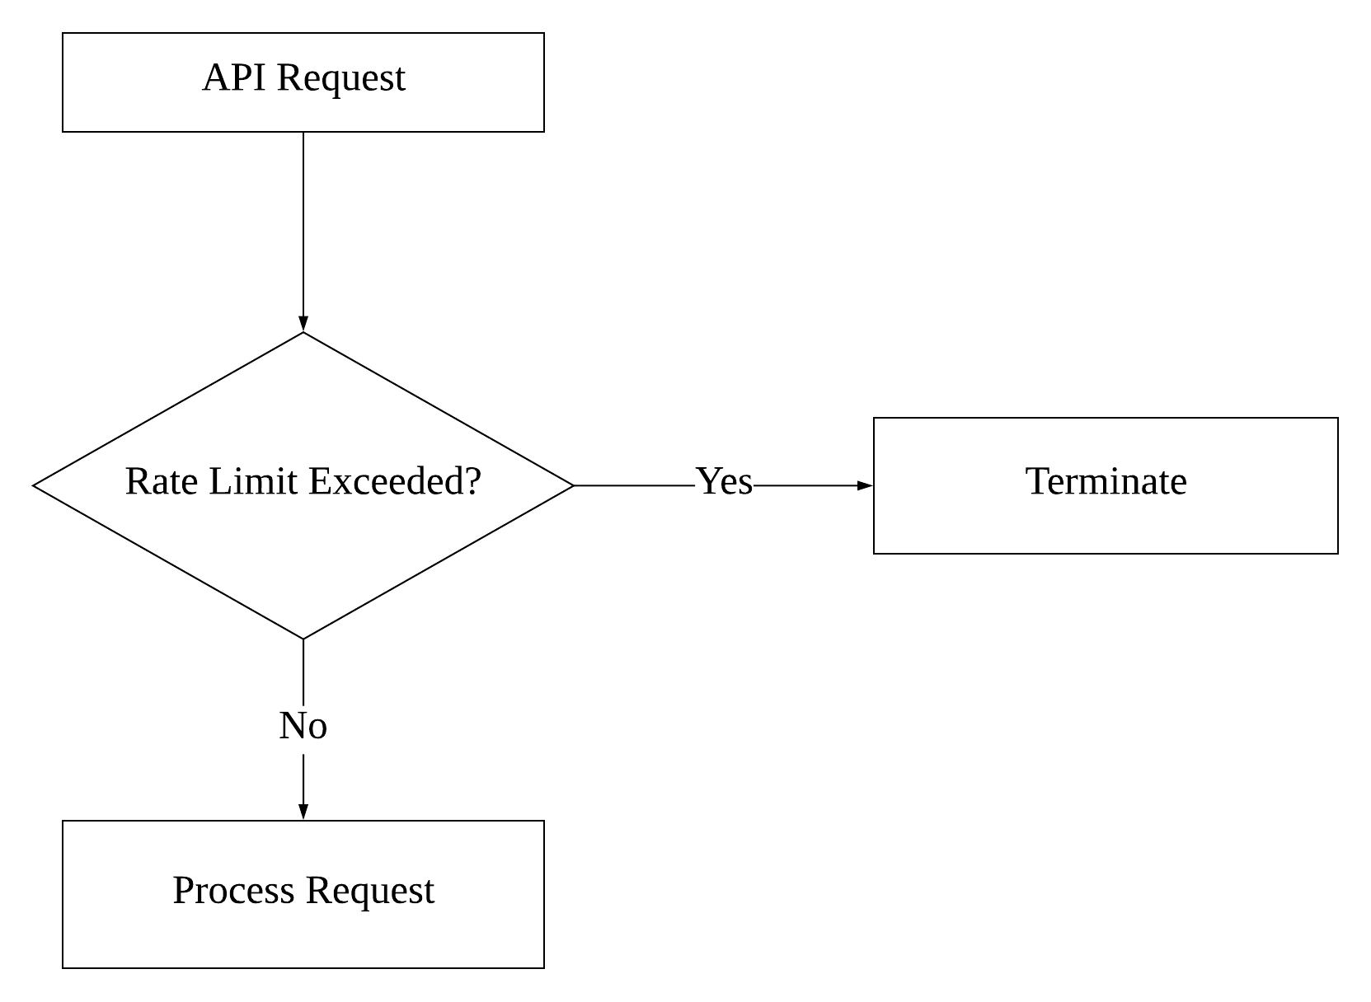
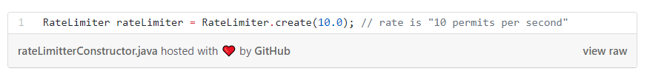
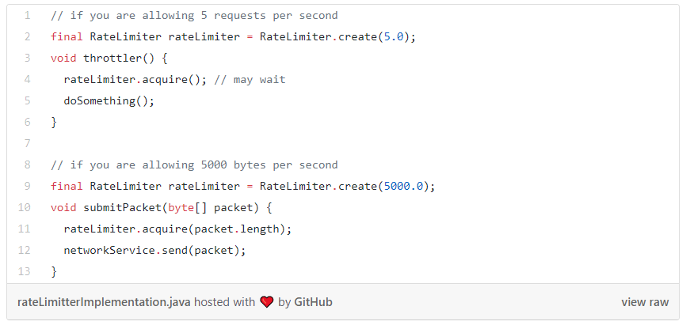
Throttling
Throttling is the process of limiting the rate that an API is being used in a server. It limits the number of service requests which can be executed in a unit time (for a second, minute..).
Create a RateLimit class to specify the maximum request per second you want

Slide 17
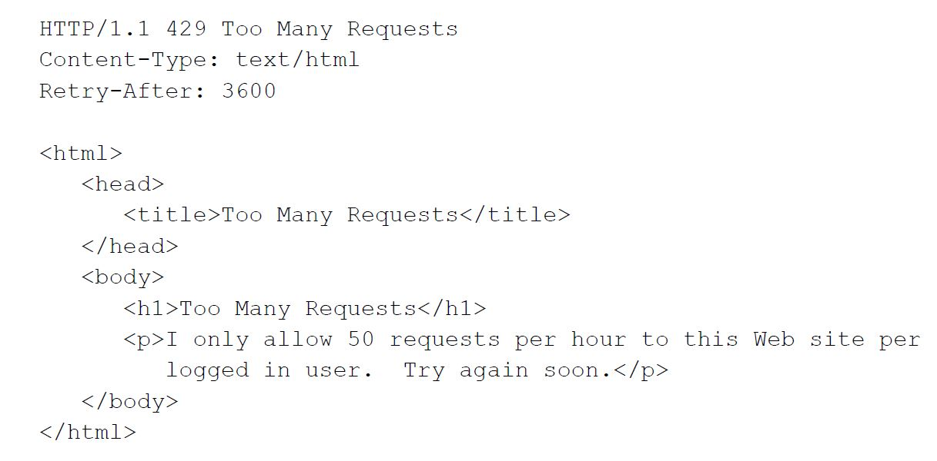
Throttling
Error code 429
The purpose of the 429 return code is to prevent repeated API requests. It’s up to you to determine how many requests are too many in any given time, but this return code is a must. It provides you with a mechanism to provide DDoS attacks, which could cause a system outage.

Slide 18
Error Handling
Respond with generic error messages. Do not reveal unnecessary failure details
Do not expose technical details such as call stacks to the client

Slide 19
Input Parameter Validation
Validate all input parameters
Use the proper HTTP method according to the operation:
GET (read)
POST (create)
PUT/PATCH (replace/update)
DELETE (to delete a record)
Respond with 405 Method Not Allowed if the requested method isn't appropriate for the requested resource
Validate input length / range / format and type

Slide 20
Input Parameter Validation
Achieve an implicit input validation by using strong types in API parameters
Numbers
Booleans
Dates
Times
Fixed data ranges
Enhance string input validation with Regular Expression
Reject unexpected/illegal content
Define request size limit
Reject requests exceeding the limit and return HTTP response status 413

Slide 21
Use Proven Solutions
The first rule of security is: Do not invent your own
Secure API Architectures
The best way to secure your API from any type of intrusion is to separate out API implementation and API security into distinct tiers

Slide 22
Cross-Origin Resource Sharing (CORS)
Cross-Origin Resource Sharing (CORS) is a W3C standard to specify what cross-domain requests is permitted
By using appropriate CORS Headers, the REST API signals to the browser which http domains are allowed to make associated JavaScript calls to the REST service
One of the main reasons of using CORS is to allow own digital channels to interface with your private APIs
Your private APIs have to use CORS to prevent someone other than the digital channels to interface with them.
CORS HTTP Headers

Slide 23
CORS - Design Considerations
Disable CORS headers if cross-domain calls are not supported
Opening you APIs to public CORS requests as specific as possible and as general as necessary
Restrict CORS requests using whitelisted of origins
Use whitelist to control allow origin, either read from external file list or DB
Cross-Site Request Forgery (CSRF) prevention to prevent origin spoofing
Minimizing preflight options to restrict unnecessary http methods that API does not support

Slide 24
CORS - Whitelist Java Spring Code Sample
@Configuration
@EnableWebSecurity
@EnableGlobalMethodSecurity(prePostEnabled = true)
public class SecurityHandler extends WebSecurityConfigurerAdapter {
@Value("#{'${whiteListAllowOrigins}'.split(',')}")
List<String> whiteListAllowOrigins;
@Override
protected void configure(HttpSecurity http) throws Exception {
http.csrf().disable().authorizeRequests().anyRequest().permitAll();
}
@Bean
public FilterRegistrationBean corsFilter() {
final UrlBasedCorsConfigurationSource source = new UrlBasedCorsConfigurationSource();
CorsConfiguration config = new CorsConfiguration();
config.setAllowCredentials(true);
config.setAllowedOrigins(whiteListAllowOrigins);
config.setAllowedHeaders(Arrays.asList("Access-Control-Allow-Headers", "Access-Control-Allow-Origin", "Access-Control-Request-Method",
"Access-Control-Request-Headers", "Origin", "Cache-Control", "Content-Type", "Authorization"));
config.setAllowedMethods(Arrays.asList("DELETE", "GET", "POST", "PATCH", "PUT"));
source.registerCorsConfiguration("/**", config);
FilterRegistrationBean bean = new FilterRegistrationBean(new CorsFilter(source));
bean.setOrder(0);
return bean;
}
}

Slide 25
OWASP
The Open Web Application Security Project (OWASP) is a nonprofit foundation that works to improve the security of software. Through community-led open source software projects, hundreds of local chapters worldwide, tens of thousands of members, and leading educational and training conferences, the OWASP Foundation is the source for developers and technologists to secure the web.

Slide 26
OWASP
OWASP Top 10 API Security Risks
https://owasp.org/www-project-api-security/
API1:2019 Broken Object Level Authorization
APIs tend to expose endpoints that handle object identifiers, creating a wide attack surface Level Access Control issue. Object level authorization checks should be considered in every function that accesses a data source using an input from the user.
API2:2019 Broken User Authentication
Authentication mechanisms are often implemented incorrectly, allowing attackers to compromise authentication tokens or to exploit implementation flaws to assume other user’s identities temporarily or permanently. Compromising system’s ability to identify the client/user, compromises API security overall.
API3:2019 Excessive Data Exposure
Looking forward to generic implementations, developers tend to expose all object properties without considering their individual sensitivity, relying on clients to perform the data filtering before displaying it to the user.

Slide 27
OWASP
OWASP Top 10 API Security Risks
API4:2019 Lack of Resources & Rate Limiting
Quite often, APIs do not impose any restrictions on the size or number of resources that can be requested by the client/user. Not only can this impact the API server performance, leading to Denial of Service (DoS), but also leaves the door open to authentication flaws such as brute force.
API5:2019 Broken Function Level Authorization
Complex access control policies with different hierarchies, groups, and roles, and an unclear separation between administrative and regular functions, tend to lead to authorization flaws. By exploiting these issues, attackers gain access to other users’ resources and/or administrative functions.
API6:2019 Mass Assignment
Binding client provided data (e.g., JSON) to data models, without proper properties filtering based on a whitelist, usually lead to Mass Assignment. Either guessing objects properties, exploring other API endpoints, reading the documentation, or providing additional object properties in request payloads, allows attackers to modify object properties they are not supposed to.

Slide 28
OWASP
OWASP Top 10 API Security Risks
API7:2019 Security Misconfiguration
Security misconfiguration is commonly a result of unsecure default configurations, incomplete or ad-hoc configurations, open cloud storage, misconfigured HTTP headers, unnecessary HTTP methods, permissive Cross-Origin resource sharing (CORS), and verbose error messages containing sensitive information.
API8:2019 Injection
Injection flaws, such as SQL, NoSQL, Command Injection, etc., occur when untrusted data is sent to an interpreter as part of a command or query. The attacker’s malicious data can trick the interpreter into executing unintended commands or accessing data without proper authorization.
API9:2019 Improper Assets Management
APIs tend to expose more endpoints than traditional web applications, making proper and updated documentation highly important. Proper hosts and deployed API versions inventory also play an important role to mitigate issues such as deprecated API versions and exposed debug endpoints.

Slide 29
OWASP
OWASP Top 10 API Security Risks
API10:2019 Insufficient Logging & Monitoring
Insufficient logging and monitoring, coupled with missing or ineffective integration with incident response, allows attackers to further attack systems, maintain persistence, pivot to more systems to tamper with, extract, or destroy data. Most breach studies demonstrate the time to detect a breach is over 200 days, typically detected by external parties rather than internal processes or monitoring.

Slide 30
OWASP
OWASP Top 10 API Security Risks
https://owasp.org/www-project-api-security/
API1:2019 Broken Object Level Authorization
APIs tend to expose endpoints that handle object identifiers, creating a wide attack surface Level Access Control issue. Object level authorization checks should be considered in every function that accesses a data source using an input from the user.
API2:2019 Broken User Authentication
Authentication mechanisms are often implemented incorrectly, allowing attackers to compromise authentication tokens or to exploit implementation flaws to assume other user’s identities temporarily or permanently. Compromising system’s ability to identify the client/user, compromises API security overall.
API3:2019 Excessive Data Exposure
Looking forward to generic implementations, developers tend to expose all object properties without considering their individual sensitivity, relying on clients to perform the data filtering before displaying it to the user.
API4:2019 Lack of Resources & Rate Limiting
Quite often, APIs do not impose any restrictions on the size or number of resources that can be requested by the client/user. Not only can this impact the API server performance, leading to Denial of Service (DoS), but also leaves the door open to authentication flaws such as brute force.
API5:2019 Broken Function Level Authorization
Complex access control policies with different hierarchies, groups, and roles, and an unclear separation between administrative and regular functions, tend to lead to authorization flaws. By exploiting these issues, attackers gain access to other users’ resources and/or administrative functions.
API6:2019 Mass Assignment
Binding client provided data (e.g., JSON) to data models, without proper properties filtering based on a whitelist, usually lead to Mass Assignment. Either guessing objects properties, exploring other API endpoints, reading the documentation, or providing additional object properties in request payloads, allows attackers to modify object properties they are not supposed to.
API7:2019 Security Misconfiguration
Security misconfiguration is commonly a result of unsecure default configurations, incomplete or ad-hoc configurations, open cloud storage, misconfigured HTTP headers, unnecessary HTTP methods, permissive Cross-Origin resource sharing (CORS), and verbose error messages containing sensitive information.
API8:2019 Injection
Injection flaws, such as SQL, NoSQL, Command Injection, etc., occur when untrusted data is sent to an interpreter as part of a command or query. The attacker’s malicious data can trick the interpreter into executing unintended commands or accessing data without proper authorization.
API9:2019 Improper Assets Management
APIs tend to expose more endpoints than traditional web applications, making proper and updated documentation highly important. Proper hosts and deployed API versions inventory also play an important role to mitigate issues such as deprecated API versions and exposed debug endpoints.
API10:2019 Insufficient Logging & Monitoring
Insufficient logging and monitoring, coupled with missing or ineffective integration with incident response, allows attackers to further attack systems, maintain persistence, pivot to more systems to tamper with, extract, or destroy data. Most breach studies demonstrate the time to detect a breach is over 200 days, typically detected by external parties rather than internal processes or monitoring.

Slide 31
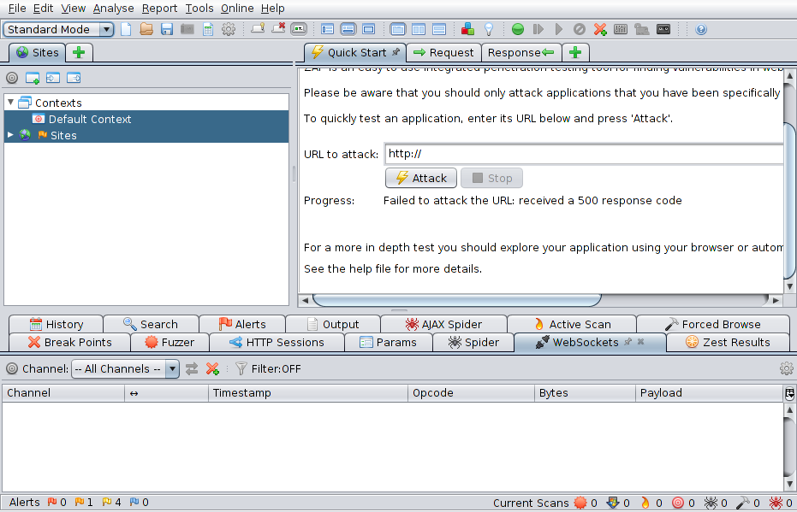
OWASP
OWASP Zed Attack Proxy (ZAP)
ZAP is a free, an open-source web application security scanner. It is intended to be used by both those new to application security as well as professional penetration testers.

Slide 32
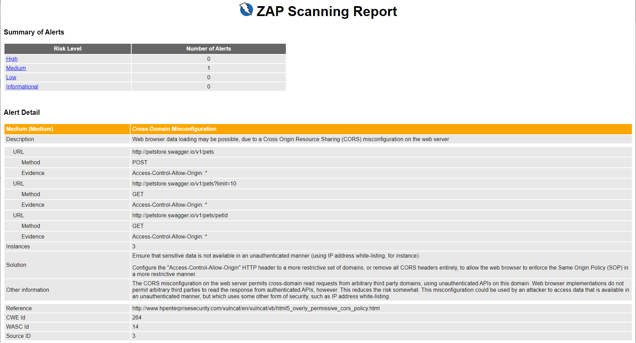

Slide 33
ZAP
Demonstration

Slide 34
Summary
Apply Rigorous Authentication and Authorization
Turn On SSL Everywhere
Information Expose on URLs
Endpoint Protection
Error Handling
Input Parameter Validation
Use Proven Solutions
CORS

